Slide 1

Utah 2065
A Story of Growth and Change
November 2025

Slide 2
Background
Official numbers – These projections inform statewide planning coordination.
Prepared every four years – Includes 15 months of data analysis, programming, outreach, and production.
Expert review – Process and products reviewed with subject matter experts across government, academia, nonprofit research institutions, and other states who do similar work.
Notes:
Including Utah Economic Council, peers in other states who do population projection work, Beth, MPOs, UDOT, Division of Water Resources

Slide 3
Critical Points of Context
“Most likely” – Future is unknowable, but not all outcomes are equally likely. We model current trends and apply judgment to create a baseline future. Other scenarios are possible, but less likely. The success of the Utah economy drives these projections.
Uncertainty – Projections are subject to error. The further out and the more detailed the greater the error. Past vintages of projections have had a 20-year error rate ranging from 2.2% to 10.9% for total population at the state level.
Active participants – We are not just witnesses of the future; we are active participants. Dramatic changes in our fertility propensities, life expectancy, migration patterns, or economic attractiveness will significantly impact these projections.

Slide 4
Major Assumptions
Fertility – Utah’s total fertility rate (births per woman) has declined or stayed constant for 16 consecutive years, falling from 2.68 in 2007 to 1.80 today. We apply an exponential decay model to project Utah’s future fertility. We assume Utah’s fertility approaches, but never reaches, national fertility projections.
Mortality – Utah’s life expectancy, except for the COVID pandemic period, continues to gradually increase for both males and females. We assume life expectancy for males will increase from 78.2 in 2024 to 83.3 in 2065 and females will increase from 82.1 in 2024 to 86.6 in 2065.
Migration – We assume a full employment economy that tracks national employment trends by industry. When natural change fails to meet Utah’s employment demand, we meet the demand with labor-related migration.

Slide 5
Total Fertility Rates
2.65
Sources: Kem C. Gardner Policy Institute, U.S. Census Bureau, National Center for Health Statistics.

Slide 6
Life Expectancy: Female
Historical
Projected
Sources: Kem C. Gardner Policy Institute, U.S. Census Bureau, National Center for Health Statistics.

Slide 7
Life Expectancy: Male
Historical
Projected
83.3
78.2
Sources: Kem C. Gardner Policy Institute, U.S. Census Bureau, National Center for Health Statistics.

Slide 8
Utah Population Growth Axioms 2025
Growth and change are Utah’s constant companions. Utah continues to outpace the nation.
Utah’s rate of growth moderates almost every year.
Net in-migration is Utah’s new norm, with some exceptions.
Utah continues to age.
Counties experience this growth in different ways.

Slide 9
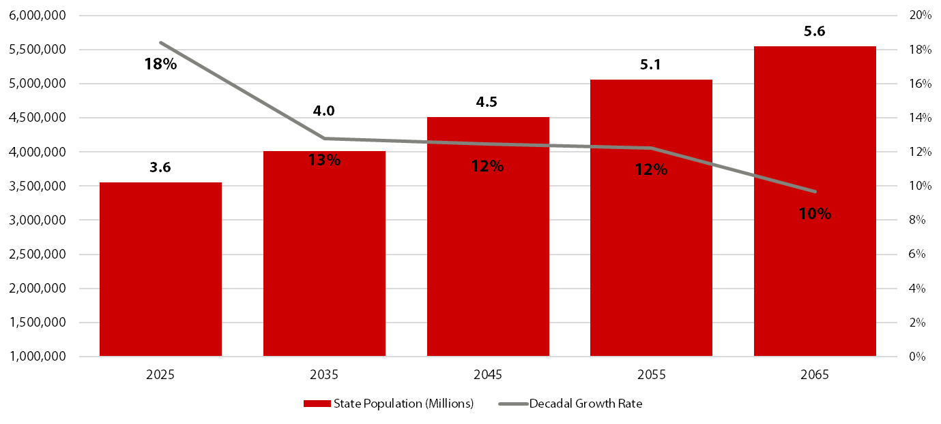
Utah Projected Population Growth
Source: Kem C. Gardner Policy Institute, 2025-2065 Projections

Slide 10
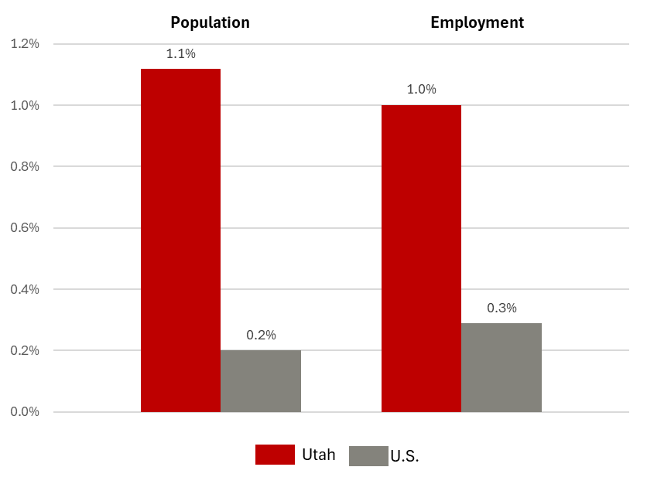
Projected Average Annual Rate of Change, 2025-2065
Source: Kem C. Gardner Policy Institute, 2025-2065 Projections; and calculations and extrapolations based on U.S. projections by the U.S. Census Bureau and S&P Global Insight.

Slide 11
Utah Population Growth Rates
Annual Average Rate of Change by Decade

Slide 12
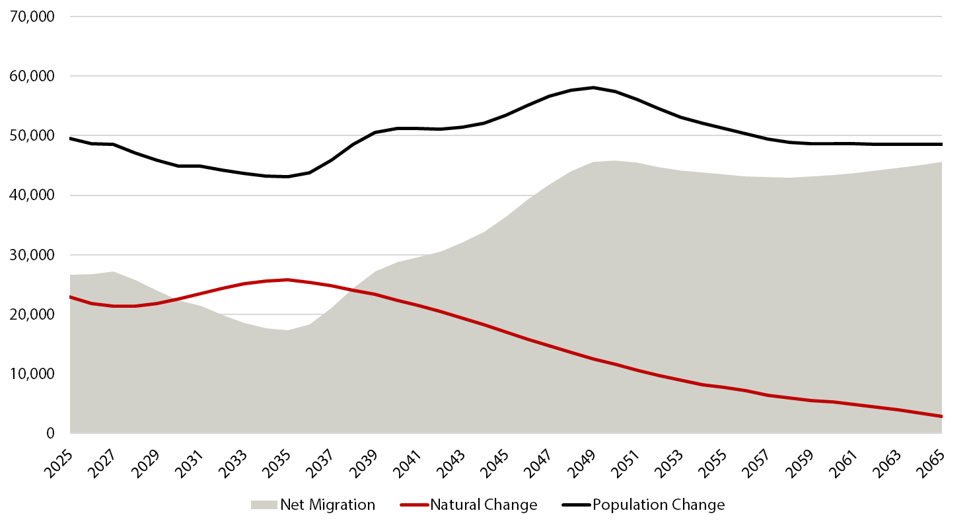
Projected Utah Components of Change
Source: Kem C. Gardner Policy Institute, 2025-2065 Projections
Notes:
Lower births and an older population, combined with a growing economy, lead to migration playing an increased role in future growth

Slide 13
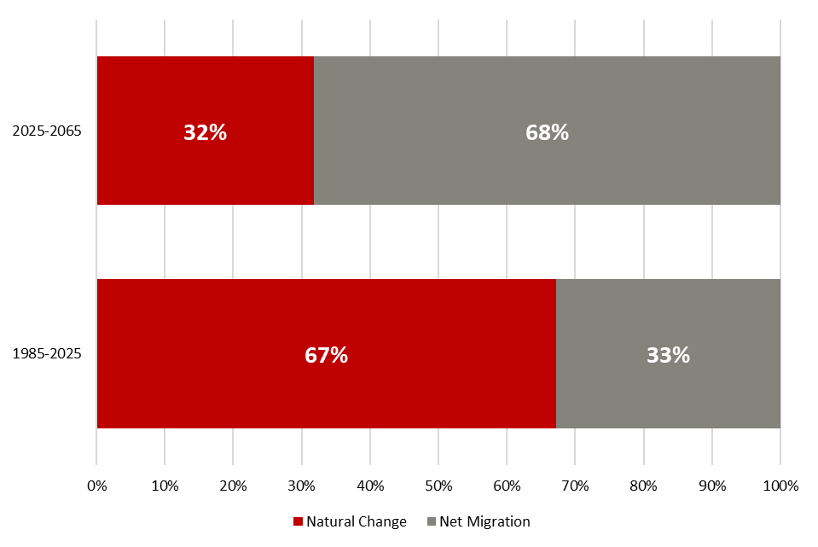


Historical and Projected Components of Change
Source: Kem C. Gardner Policy Institute, Utah Population Estimates Committee, and Utah Population Committee
Kem C. Gardner Policy Institute
DAVID ECCLES SCHOOL OF BUSINESS UNIVERSITY OF UTAH

Slide 14
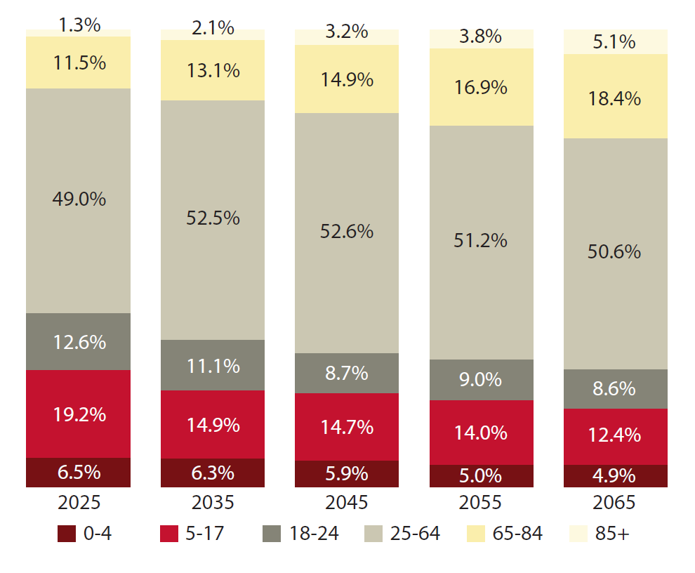
Utah’s Projected Population by Age
Source: Kem C. Gardner Policy Institute, 2025-2065 Projections
Notes:
Lower births and an older population, combined with a growing economy, lead to migration playing an increased role in future growth

Slide 15
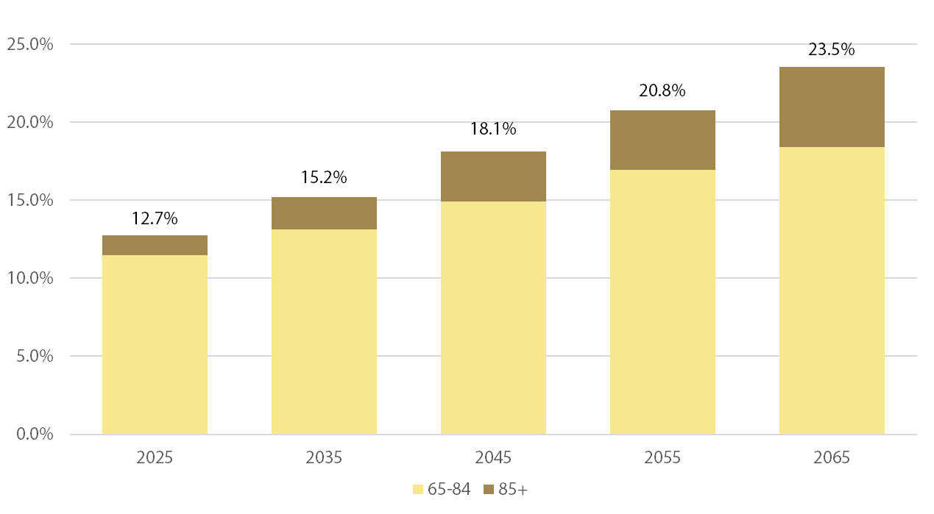
Utah Projected Population Aged 65+
Source: Kem C. Gardner Policy Institute, 2025-2065 Projections

Slide 16
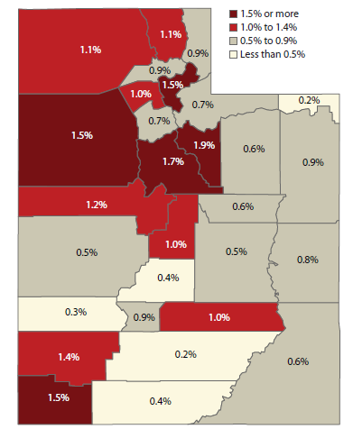
Growth rates vary throughout the state, from 0.2% to 1.9% over the projection horizon. No county contracts.
Average Annual Rate of Population Change 2025-2065
Source: Kem C. Gardner Policy Institute, 2025-2065 Projections

Slide 17
Utah’s Fastest Growing Counties, 2025-2065
Annual Average Rate of Change
Source: Kem C. Gardner Policy Institute, 2025-2065 Projections

Slide 18
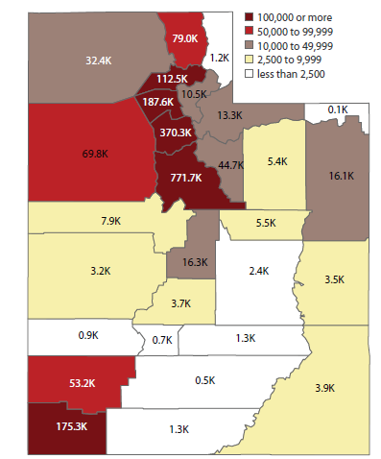
Utah County adds, by far, the most new residents over the projection horizon.
Projected Population Change (in thousands) 2025-2065
Source: Kem C. Gardner Policy Institute, 2025-2065 Projections

Slide 19
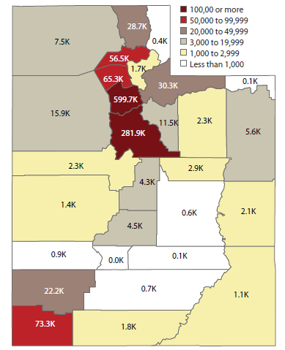
Salt Lake County remains Utah’s urban and economic center.
Projected Employment Change (in thousands) 2025-2065
Source: Kem C. Gardner Policy Institute, 2025-2065 Projections

Slide 20
Considerations
Relative housing affordability – What if Utah’s currently 10th most expensive housing market continues or worsens?
Workforce attractiveness – What if Utah’s currently 3rd most well-trained and well-educated workforce declines relative to other states?
Life quality – What if Utah’s life quality measures (relative convenience, access to nature, low crime, affordability) falter and impact regional attractiveness?
Transportation and water – What if Utah fails to invest and properly manage transportation and water infrastructure and usage and congestion and lack of water availability compromise the state’s economic competitiveness?

Slide 21
Thanks to the long-term planning projections team and our reviewers
Mike Hollingshaus, Senior Demographer
Michael Hogue, Senior Research Statistician
Mallory Bateman, Director of Demographic Research
Nate Lloyd, Director of Economic Research
Kristina Bishop, Research Economist
Emily Harris, Senior Demographer
Megan Rabe, Research Associate

